Slide 1
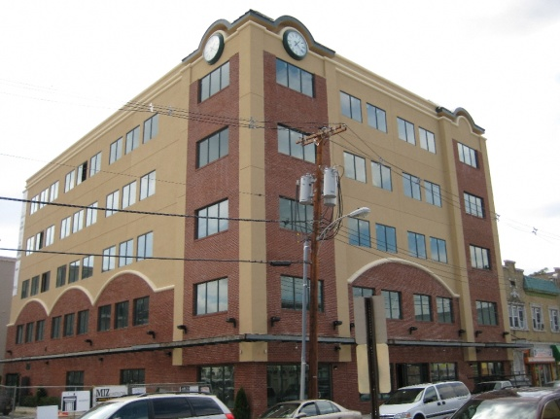

Lakewood Resource & Referral Center
212 SECOND STREET, SUITE 204
LAKEWOOD, NEW JERSEY 08701
Notes:
1

Slide 2
The topics we’ll be covering
The Business Model – Why It’s Important
Expense and Cash Flow Management
Collaboration
Evaluation

Slide 3
Brief note before we start
Business is Business
All businesses , whether for-profit or non-profit
All strive to manage with efficiency and be positioned for sustainability, growth and success.

Slide 4
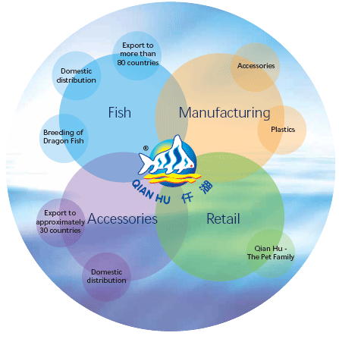
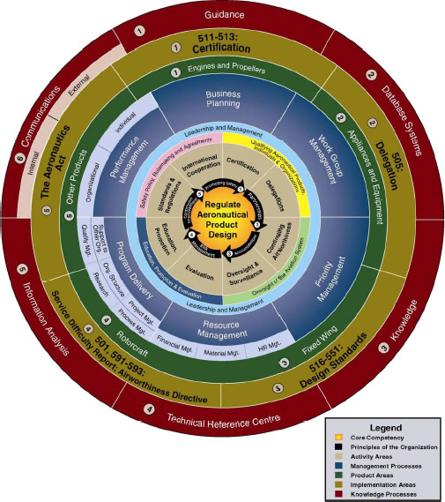
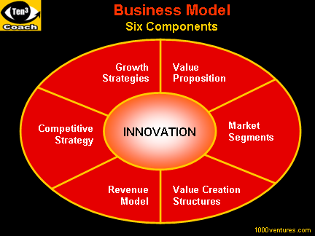
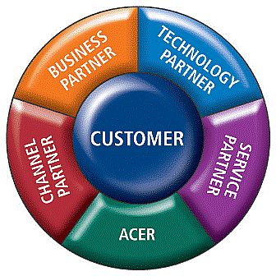
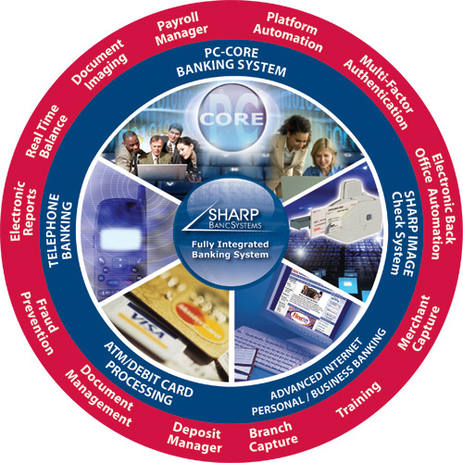
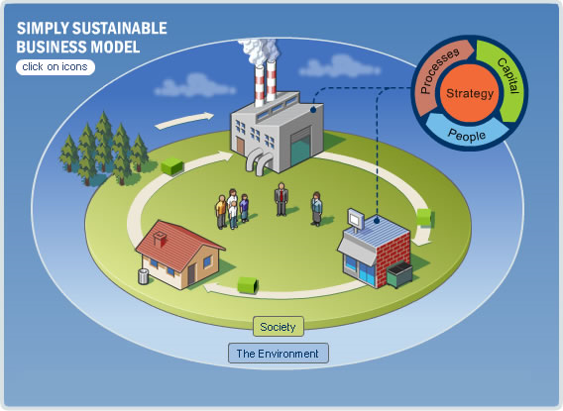
The Business Model

Slide 5

Understanding the Business Model
The Business Model
How
What
Who
Expenses
Revenue
Notes:
5

Slide 6



What Are We offering
What is their mission
What product or service do they Offer
To Refresh The World
Refreshing Drinks
To Provide relief to victims of disaster
Disaster relief assistance programs
Saving People money so they can live better
High Quality Products for cheaper
Notes:
What is our agency’s mission
What are we looking to provide to achieve that mission
An example is coke
What is their mission
What do they provide to achieve that mission
Another example is Red Cross
Another example is Wal-Mart
rty

Slide 7

Who Are We offering this to
Who is our market
1. The Recipient
2.The Sponsor
Provide programs for young people that build character, etc.
Two markets to understand
Two potential revenue sources
The Recipient
They charge a $15 Registration Fee
The Sponsor
They provide a service to all sponsors looking to promote character building in Youth
Notes:
This aspect of the business model focuses on who the offer is to be made to
The difference between for profit and non-profit in this aspect
It’s important to understand that - Non Profit agencies are essentially the tool that is used by sponsors to outsource their own mission
Thus – the offer will always be to two targets of the agency’s offer
This is important when assessing the target market
This provides two sources of potential funding
Take the red cross example
This is an important aspect that’s often overlooked in non-profits
This is an offer that can be marketed to sponsors as well

Slide 8
Assessing Target Market
Psychographic information
Includes lifestyle data like hobbies, interests, opinions, etc.
Geographic information
Includes information about where the subject lives and where he or she purchases products and services. This can be as broad as the country or state in which they live, or as narrow as the county, city and neighborhood.
Behavioral information
Includes information about how the subject uses products or services.
Benefit information
Includes information about the perceived benefits the subject receives from products and services.
Demographic information
Includes age, gender, nationality (if necessary), etc.
Notes:
Understanding your target markets values
Understanding your target markets needs
Helps in providing better services
Helps in distributing the offer i.e. marketing

Slide 9

How Can We Offer this
What resources are needed?
Physical
Manufacture
Distribute
Financial
Social
Market
Office space
Personnel
Intellectual
Notes:
Crocs
What is their offer
What is needed provide their offer to the target market
Footwear designers
A footwear manufacturer
A means of communicating the offer to the target market
A means to distribute the offer to the target market
Can Be broken down into four categories
Physical resources
Financial resources
Social resources
Intellectual resources

Slide 10
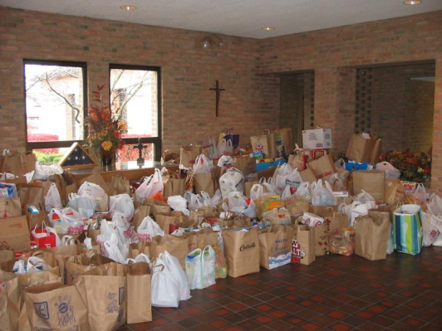

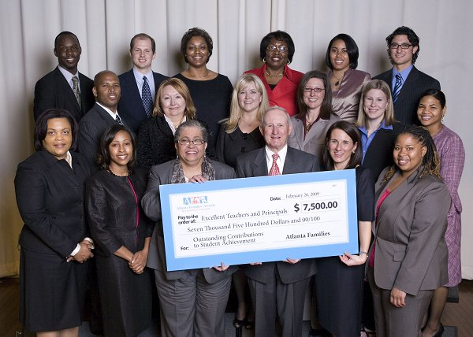
Expenses
Program Expenses
Administrative Expenses
Fundraising Expenses
Notes:
This aspect of the business model focuses on the financial component related to delivering the offer
it can be broken down into three categories
Program expenses
Administrative expenses
Fundraising expenses
Simple example – non profit agency

Slide 11

Revenue
The sponsor
The recipient of the offer
Educating American citizens
For the federal government
Education
Students
$$
$$
Revenue
Notes:
Again the offer is to two aspects of the market
1. the sponsor
2. the recipient of the product
Example

Slide 12




Using the Mission statement as a guide for Growth
Duck food foundation
Animal food foundation
Love the Animals Corp
Mission –
To provide love to the animals of the universe
Offer -
Feed the ducks program
Offer -
Feed the Animals program
Revenue
Notes:
Take a fictitious non profit
Show the mission statement
Show how adding programs
adding target markets
and adding values can significantly enhance revenue

Slide 13
By optimizing the efficiency of these five areas, an agency can position itself for substantial growth and sustainability
How
What
Who
Expenses
Revenue

Slide 14
Cash flows & Expenses
$$$

Slide 15
Managing Cash Flows
January
February
March
Cash Revenues
- Revenue from Sponsors
- Revenue from services
$100
$150
$200
Cash Disbursement
- Rent
Utilities
Salaries
$50
$50
$50
Cash Reconciliation
$0
$50
$150
Opening Cash Balance
+ Total Cash Revenues
Total Cash Disbursements
= Closing cash balance
$100
$150
$200
$50
$50
$50
$50
$150
$300
Notes:
What is it
One of the most powerful management tools
the most essential tool needed to develop a budget
Three sections
1.Cash Revenues
2.Cash disbursements
3.Cash reconciliation
Details the expected cash inflow sources
while some sources may be know others may not be
Details the expected cash outflow sources

Slide 16
Managing Cash Flows
Projecting cash flows
Managing Cash Surplus
Managing Cash Deficit
Pay Down Line of Credit
Invest in short term Instruments
Invest in liquid securities
Obtain Short term loan / Line of Credit
Speed up collection of receivables
Liquidate investments
Increase fundraising efforts
Cut expenses
Anticipated Revenue
Anticipated Expenses
1
Rate of occurance x impact of the event = Risk
30% x 50% = 15%
2
Risk Related to Revenue
Risk Related to Expenses
3
Standardizing Revenue
Standardizing Expenses

Slide 17
Expenses
Program Expenses
Administrative Expenses
Fundraising Expenses
Notes:
This aspect of the business model focuses on the financial component related to delivering the offer
it can be broken down into three categories
Program expenses
Administrative expenses
Fundraising expenses
Simple example – non profit agency

Slide 18
Managing Expenses
3 keys to Expenses Management
Taxes – understanding the exemptions
Documenting expenses
Using the mission statement and business model to create expense guideline
Budgeting
Reporting – understanding the requirements
Budgeting – understanding what is necessary
Use the cash flow projections
Be thrifty
Use the business model to create an expenses guideline
Notes:
What areas of the organization are included in expenses management
Expenses guidelines can be created based on the mission statement and business model
Understanding the expenses from a tax perspective – what is deductible etc..
Understanding the expenses from a reporting perspective
Understanding the expenses from a budget perspective
Example
Advertising
Business Bad Debt
Car
Charitable Contributions
Depreciation
Entertainment
Gifts
Home Office
Insurance
Legal Fees
Organizational Expenses
Personal Property “Section 179 Election”
Rent
Salaries
Start-up Costs
Supplies and Materials
Taxes
Travel
Utilities

Slide 19




Leveraging Resources

Slide 20
Leveraging Resources
Agency Resources
Financial
Physical
Social
Intellectual
Cultural
Financial Sponsors
Cash on Hand
Loans
Receivables
Building
Websites
Computers
Desks
Agency Image
Trust
Social Media
Typically Includes patents
Community Insight
Notes:
Summing up the resources that your agency has
Physical resources
building
computers
website
Financial Resources
cash on hand
financial sponsors
Social Resources
Community image
social media
Intellectual resources
typically includes patents
one of the key intellectual resources that exist in a local non profit agency is insight into the needs of their clientel

Slide 21

Collaboration

Slide 22
Collaboration
Making the Case for Collaboration 1+1=3
Cost Sharing
Wider Target Market
Expanded Solutions
Other benefits of collaboration
Generates wiser decisions
Produces more durable decisions
Fosters action
Builds social capital
Fosters ownership of collective problems and resources
Promotes change
Notes:
The benefits of collaboration
Methods of collaboration
cost sharing
significantly expanded solutions
wider target market
Example
Benefits
Show revenue chart where 1+1=3
Generates wiser decisions
Produces more durable decisions
Fosters action
Builds social capital
Fosters ownership of collective problems and resources
Promotes change

Slide 23
Collaboration
Independent
Collaboration
Notes:
The benefits of collaboration
Methods of collaboration
cost sharing
significantly expanded solutions
wider target market
Example
Benefits
Show revenue chart where 1+1=3
Generates wiser decisions
Produces more durable decisions
Fosters action
Builds social capital
Fosters ownership of collective problems and resources
Promotes change

Slide 24


Evaluation

Slide 25
Financial Statements
What are they?
Statement of activities
snapshot of the organizations business operations
Statement of financial position
snapshot of an organizations assets, liabilities and owner’s equity
Statement of cash flows
snapshot of cash activity in operating, investing and financing areas
Notes:
The three financial statements give a snapshot of the organizations financial health over the period reported on
Statement of activities (income statement) – snapshot of the organizations business operations
statement of financial position found (Balance Sheet) – provides a snapshot of an organizations assets, liabilities and owner’s equity
Statement of cash flows – provides a snapshot of cash activity in operating, investing and financing activities
A brief analysis of these statements can provide tremendous insight on the financial stability, operational efficiency, and overall sustainability of an organization.

Slide 26
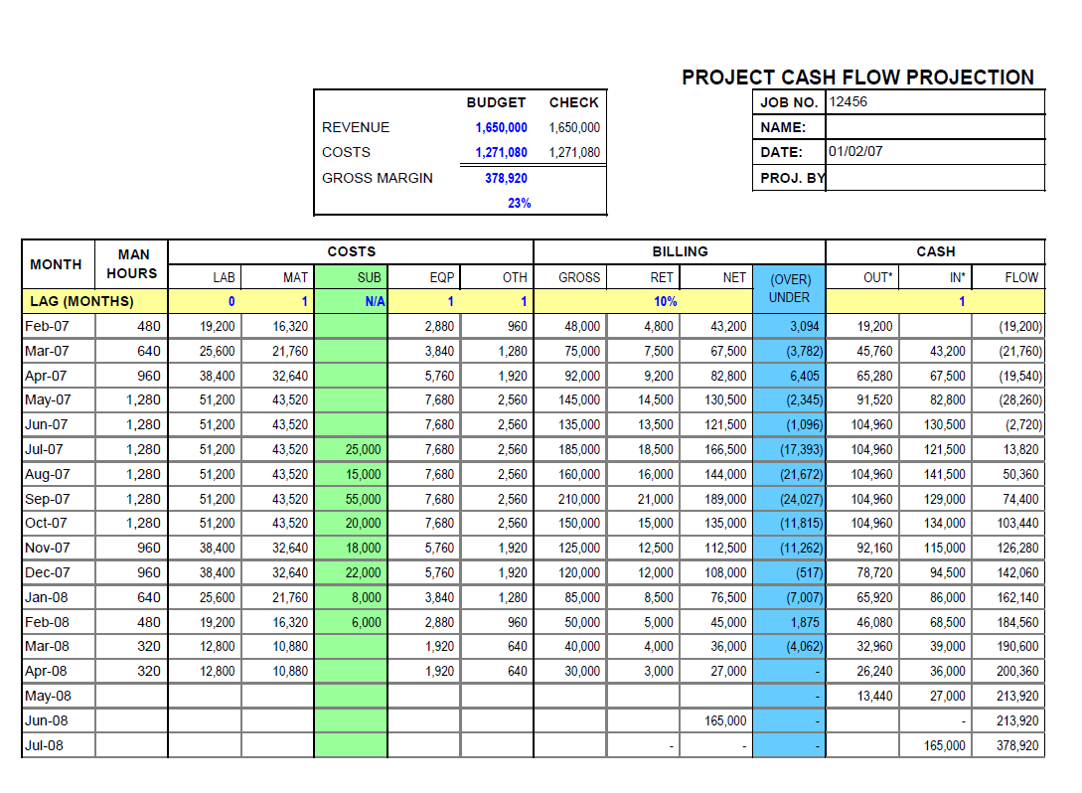
Financial Statements
Financial Statement analysis provides the quickest and most concise evaluation
Vertical Analysis
Horizontal Analysis
Provides a picture of organizational efficiency
Provides a picture of the direction the organization is headed in
Notes:
The three financial statements give a snapshot of the organizations financial health over the period reported on
Statement of activities (income statement) – snapshot of the organizations business operations
statement of financial position found (Balance Sheet) – provides a snapshot of an organizations assets, liabilities and owner’s equity
Statement of cash flows – provides a snapshot of cash activity in operating, investing and financing activities
A brief analysis of these statements can provide tremendous insight on the financial stability, operational efficiency, and overall sustainability of an organization.

Slide 27
Evaluation
Vertical Analysis
Agency A
Agency B
Revenues
$100
$300
Provides a picture of organizational efficiency
Program Expenses
$50
$200
Gross Margin
50%
33%
Gross Margin reveals the proportion of money left over from revenues after accounting for the cost of goods
Gross Margin Percentage = (Revenue-Cost of Sales)/Revenue

Slide 28
Evaluation
Horizontal Analysis
Year 1
Year 2
Growth Rate
Revenues
$100
$300
%200
Provides a picture of the direction the organization is headed in
Expenses
$50
$200
%300
Growth Rate = ( Year 2 – Year 1)/Year 1

Slide 29
Summing It All Up
The business Model
Managing the Cash Flows
Managing the Resources
Collaboration
Evaluation

Slide 30

Thank You!!
Ideas &
Q&A

